Slide 1
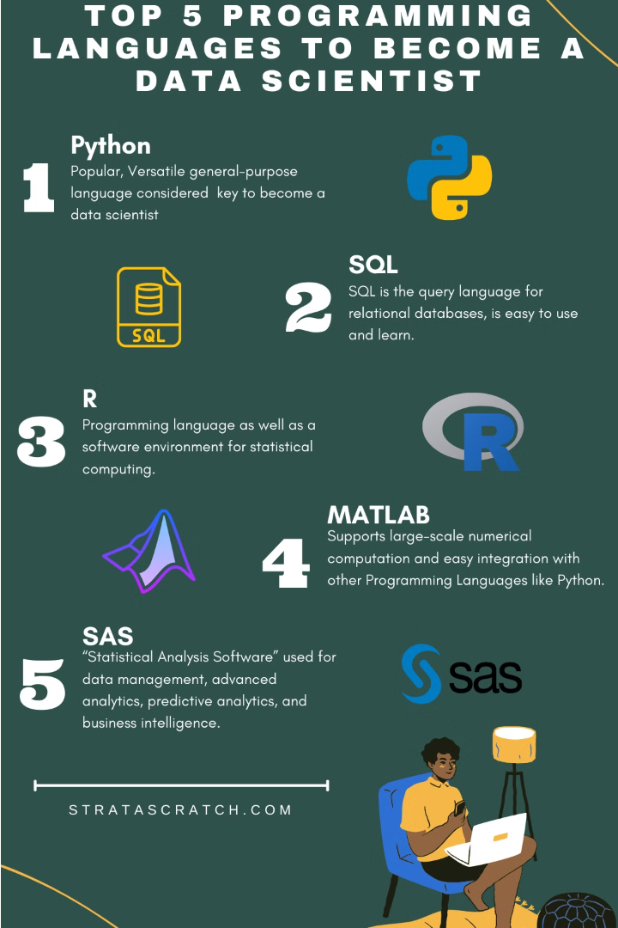


Comparing Python and R for Data Science
This research explores the performance of Python and R in hierarchical clustering tasks, analyzing their RAM and CPU usage. The study provides insights into how these languages handle data science differently.
by Zakaria Damaj

Slide 2
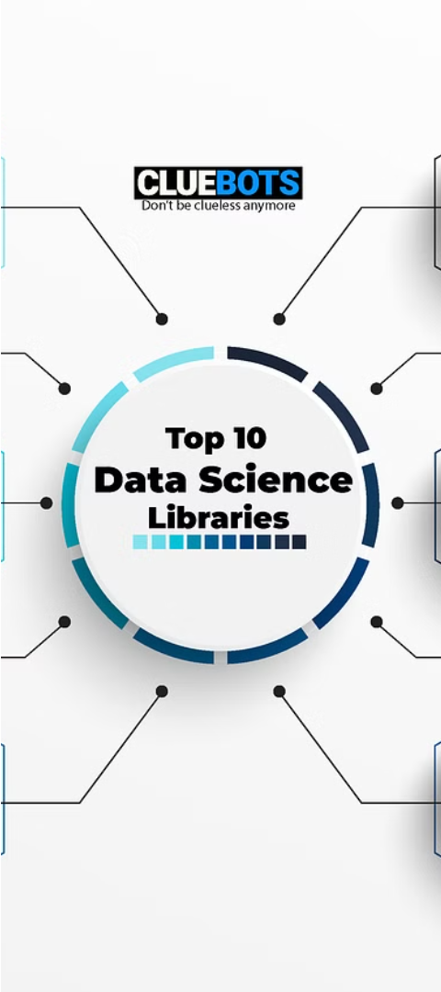
Importing Libraries and Data
1
Import Libraries
2
Load Dataset
Use pandas to import the dataset.
Import the CSV file containing customer information.

Slide 3

Building the Dendrogram
1
Create Linkage Matrix
Use linkage function from scipy.cluster.hierarchy.
2
Generate Dendrogram
Call the dendrogram function with the linkage matrix.
3
Customize Plot
Add labels and title for better visualization.

Slide 4
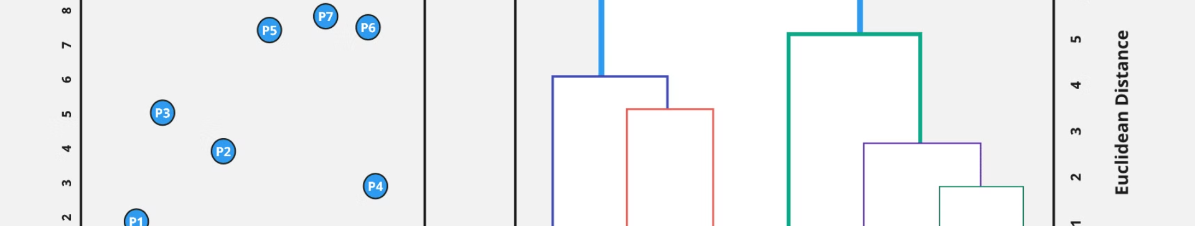
Interpreting the Dendrogram
Examine Axes
Identify Optimal Clusters
Traverse and Compare
X-axis represents observation points, Y-axis represents Euclidean distances.
Look for the largest vertical distance without crossing horizontal lines.
Start from the top, measure vertical distances, and find the largest distance.

Slide 5
Training the Hierarchical Model
Import AgglomerativeClustering
Create Model Object
Train the Model
Specify the desired number of clusters.
Use fit_predict method to train and predict cluster labels.
From Scikit-learn.

Slide 6



Comparing Python and R
RAM Usage
CPU Usage
Library Optimization
Python: 130 MB, R: 168 MB
Python: 0.6 s, R: 0.9 s
Differences in library implementation and memory management strategies.

Slide 7




Factors to Consider
Project Requirements
Language Familiarity
Performance Needs
Align with specific needs and performance demands.
Leverage expertise and ecosystem familiarity.
Evaluate resource usage for the task at hand.

Slide 8
Conclusion
1
Similar Performance
2
Underlying Differences
Both Python and R can efficiently handle hierarchical clustering for small datasets.
Understand the reasons behind variations in RAM and CPU usage.
3
Align with Project
Choose the language that best fits your project requirements and performance needs.

